Slide 1

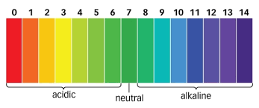

Pool Manager
Uses your pool pH & chlorine levels to let you know what chemicals need to be added
DEVELOPERS:
HANNAH FREEMAN
AUSTIN COYNE

